Slide 1

PARKINSON’S DISEASE CLASSIFICATION
17BCE112 - Nayan Shah
17BCE114 - Shail Patel
17BCE123 - Jeet Sureja

Slide 2

WHAT IS PARKINSON’S DISEASE ?
Parkinson's disease (PD) belongs to a group of conditions called motor system disorders, which cause unintended or uncontrollable movements of the body. The precise cause of PD is unknown, but some cases are hereditary while others are thought to occur from a combination of genetics and environmental factors that trigger the disease.

Slide 3
DATASET USED
(PPMI)
The Parkinson’s Progression Markers Initiative (PPMI) is a landmark observational clinical study to comprehensively evaluate cohorts of significant interest using advanced imaging, biologic sampling and clinical and behavioral assessments to identify biomarkers of Parkinson’s disease progression.
Here we are given images as data in NIfTI format, which is “Neuroimaging Informatics Technology Initiative” having extension .nii.

Slide 4
MORE ABOUT DATASET
Total 301 Brain Images
61 Parkinson positive
240 Parkinson negative (Healthy)
Dimension of Images
Vary from images to image so we have to resize images

Slide 5
RESIZING THE IMAGES
If we want to use numPy array to store and image then the size of all the images should be equal.
Thus, we have resized all the images to (256,256).

Slide 6

HERE WE HAVE USED CNN FOR CLASSIFICATION

Slide 7
WHY CNN ?
Convolutional neural networks (CNN) is a special architecture of artificial neural networks, proposed by Yann LeCun in 1988.One of the most popular uses of this architecture is image classification.
It is a special kind of multi-layer neural network which extracts visual patterns from pixel images with minimal preprocessing. The architecture of CNN has been designed in a way such that it utilizes spatial relationships to encode certain properties and reduce the number of hyper parameters and thus improves general feed-forward back propagation training. CNN models combine weights into smaller kernel filters to simplify the learning model.

Slide 8
HOW CNN WORKS ?
1
Convolutional layer
2
Non-linear layer
3
Max Pooling layer
4
Fully connected layer

Slide 9
CONVOLUTIONAL LAYER
The CONV layer is the core building block in this network which takes the input image and creates feature maps from it. A filter is just a matrix of values, called weights, that are trained to detect specific features.
Then the weight sharing is done that helps to reduce the total number of trainable parameters eventually creating a more effective model.

Slide 10
NON-LINEAR LAYER
The nonlinear layer is added after each convolution operation. It has an activation function, which brings nonlinear property. Without this property a network would not be sufficiently intense and will not be able to model the response variable (as a class label).

Slide 11
MAX POOLING LAYER
A pooling layer is usually inserted in between successive Conv layers. The function of the Pooling layer is to reduce or down sample the spatial size of the representation. This is done to reduce the huge amount of network hyper parameters and to control overfitting.

Slide 12
FULLY CONNECTED LAYER
After completion of series of convolutional, nonlinear and pooling layers, it is necessary to attach a fully connected layer. This layer takes the output information from convolutional networks. Attaching a fully connected layer to the end of the network results in an N dimensional vector, where N is the amount of classes from which the model selects the desired class.

Slide 13
FRAMEWORK USED
(KERAS)
Keras prioritize developer Experience
Keras has broad adoption in the community
Keras makes it easy to turn models into products
Keras supports multiple backend engines and does not lock you into one ecosystem
Keras has strong multi-gpu support
Keras development is backed primarily by Google, and the Keras API comes packaged in TensorFlow as tf.keras. Additionally, Microsoft maintains the CNTK Keras backend. Amazon AWS is developing MXNet support. Other contributing companies include NVIDIA, Uber, and Apple (with CoreML)

Slide 14
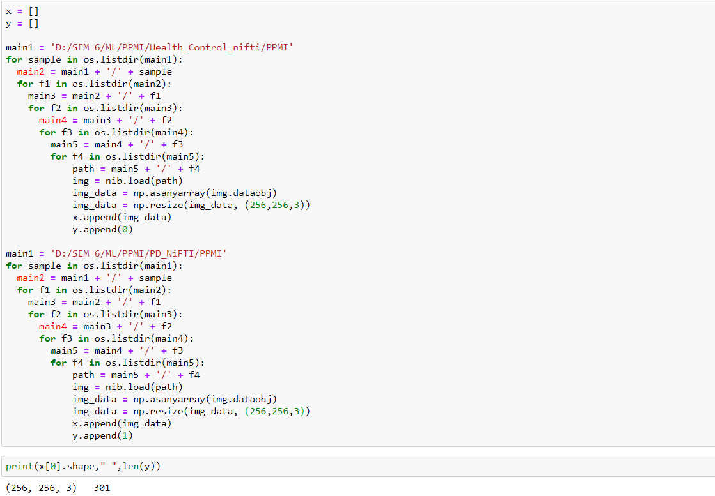
Data loading and transformation

Slide 15
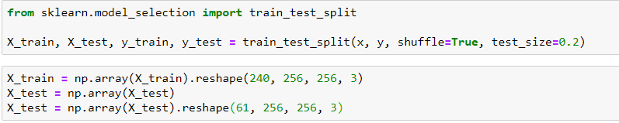
Data splitting and reshaping (80:20)

Slide 16
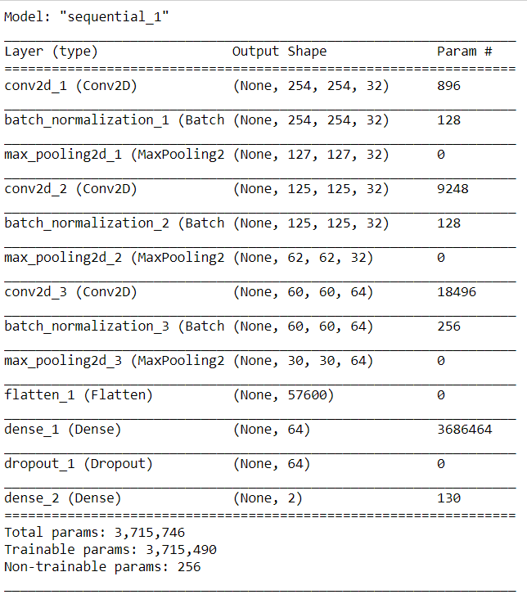
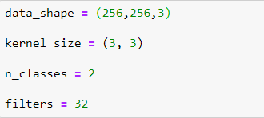
Model Details and Layered Architecture

Slide 17
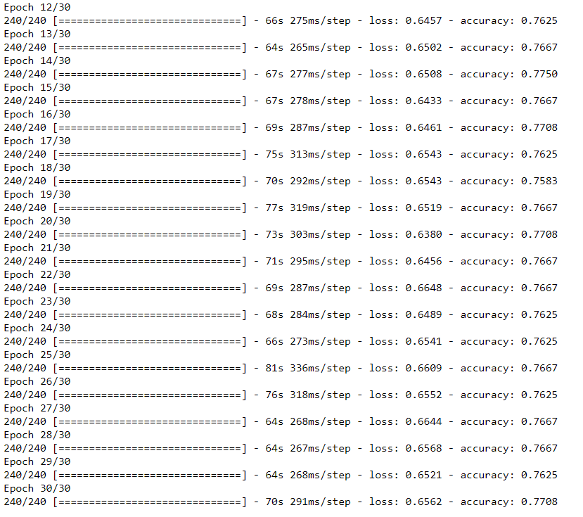
MAX TRAINING ACCURACY: 77.5 %

Slide 18
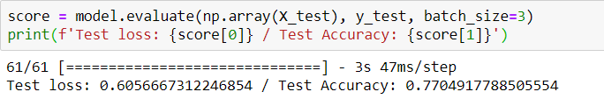
Model Evaluation: 77.05%

Slide 19
RESOURCES
https://medium.com/@ksusorokina/image-classification-with-convolutional-neural-networks-496815db12a8
https://lib.dr.iastate.edu/cgi/viewcontent.cgi?article=1305&context=creativecomponents
S. Lee, R. Hussein and M. J. McKeown, "A Deep Convolutional-Recurrent Neural Network Architecture for Parkinson’s Disease EEG Classification," 2019 IEEE Global Conference on Signal and Information Processing (GlobalSIP), Ottawa, ON, Canada, 2019, pp. 1-4, doi: 10.1109/GlobalSIP45357.2019.8969309.

Slide 20
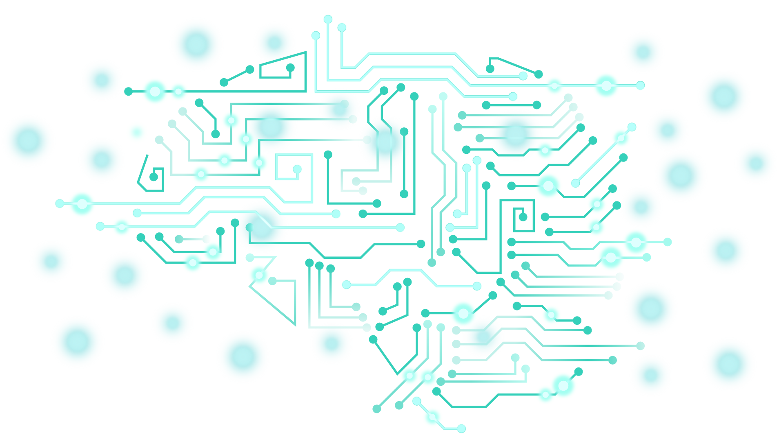
THANK YOU

